Slide 1
Branch and Bound

Slide 2
The Method
The term branch-and-bound refers to all state space search methods in which all children of the E-node are generated before any other live node can become the E-node.
Applied where greedy and dynamic programming fails
Search strategies for exploring new nodes
BFS-- FIFO search
List on live nodes in queue
D-Search-- LIFO search
List of live nodes in stack

Slide 3
Use for optimization problem
Use for minimization problem
Maximization problem convert into minimization

Slide 4
Branch AND Bound Search techniques
FIFO branch and bound-queue
LIFO branch and bound-stack
Least cost branch and bound-min heap data structure

Slide 5
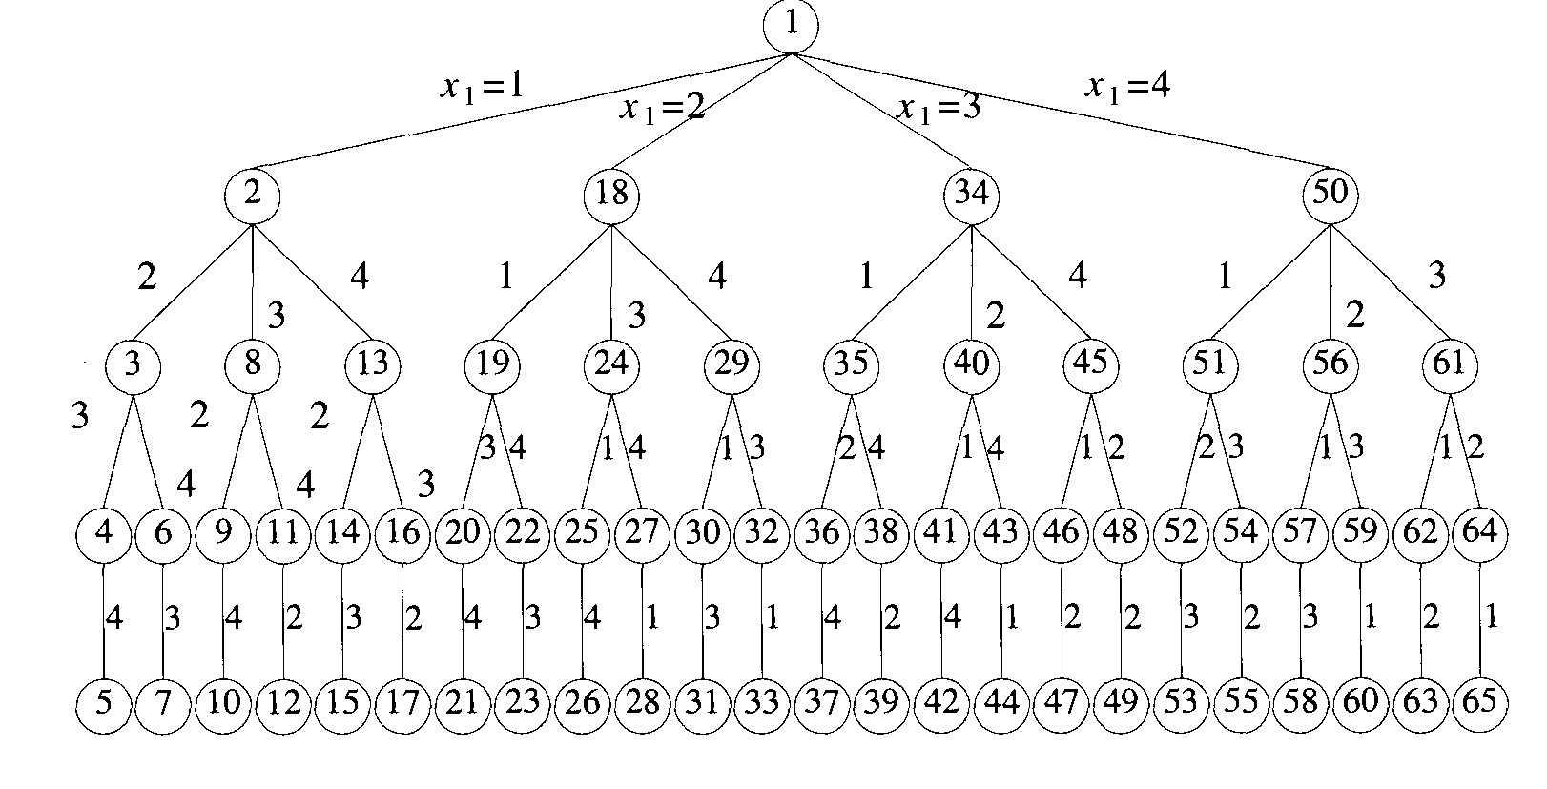
4-Queen’s problem
How FIFO branch and bound algorithm will work?

Slide 6
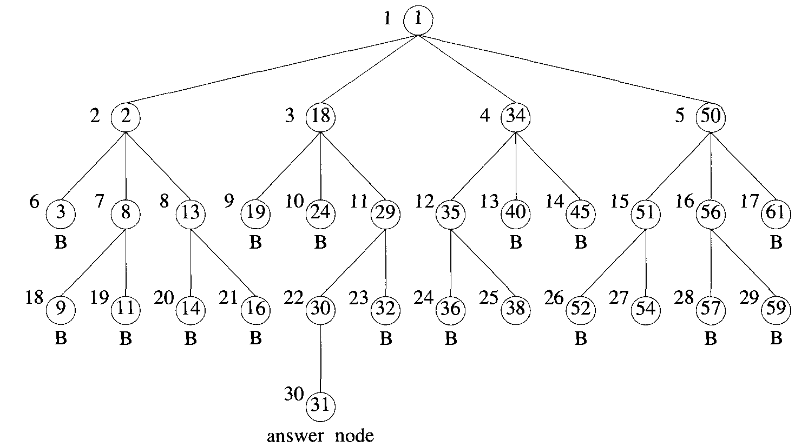
4-Queen’s problem
FIFO branch and bound---Nodes that are killed as a result of the bounding functions have a "B" under them.

Slide 7
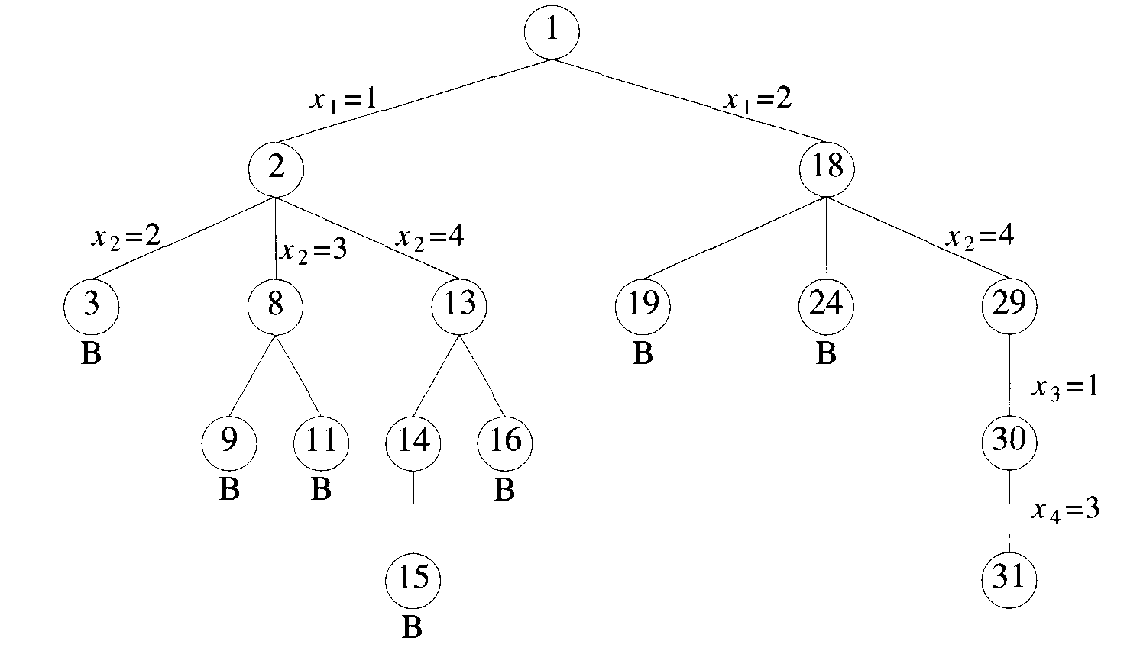
4-Queen’s problem
State space tree generated by backtracking method

Slide 8
General Branch and Bound
Algo Branch_Bound()
{
E=new(node);
// H is heap for all live nodes, may be min-heap or max-heap
while(true)
{
if (E is final leaf) then
{
// E is an optimal solution
write(path from E to root); return;
}
Expand(E);
if ( H is empty ) then
{
write(“There is no solution.”); return;
}
E=delete_top(H);
}
}

Slide 9
Least Cost Search
The rigid FIFO rule first requires the expansion of all live nodes generated before node 30 was expanded.
The search for an answer node can often be speeded by using an "intelligent" ranking function c^(.) for live nodes. The next E-node is selected on the basis of this ranking function.
If in the 4-queens example we use a ranking function that assigns node 30 a better rank than all other live nodes, then node 30 will become the E-node following node 29.

Slide 10
Least Cost Search
At each node, cost(rank) c^( .) is calculated.
The cost could be
The number of nodes in the subtree x that need to be generated before an answer node is generated
the number of levels the nearest answer node (in the subtree x) is from x.
Let’s see measure 2 for 4-queen’s problem.
Instead of computing the actual cost of the node, rank the nodes only on the basis of estimate g^(.) of their cost.

Slide 11

Least Cost Search
Ranking function - c^(x)
Estimate of the efforts to reach answer node – g^(x)
Actual cost of reaching x from root – h(x)
Node x is assigned ranking function such that
If g^(x)=0 and f(h(x)) is the level of node x, then this is essentially same as BFS.
If f(h(x))=0 and g^(x)>=g^(y) where y is child of x, this is same as D-search

Slide 12
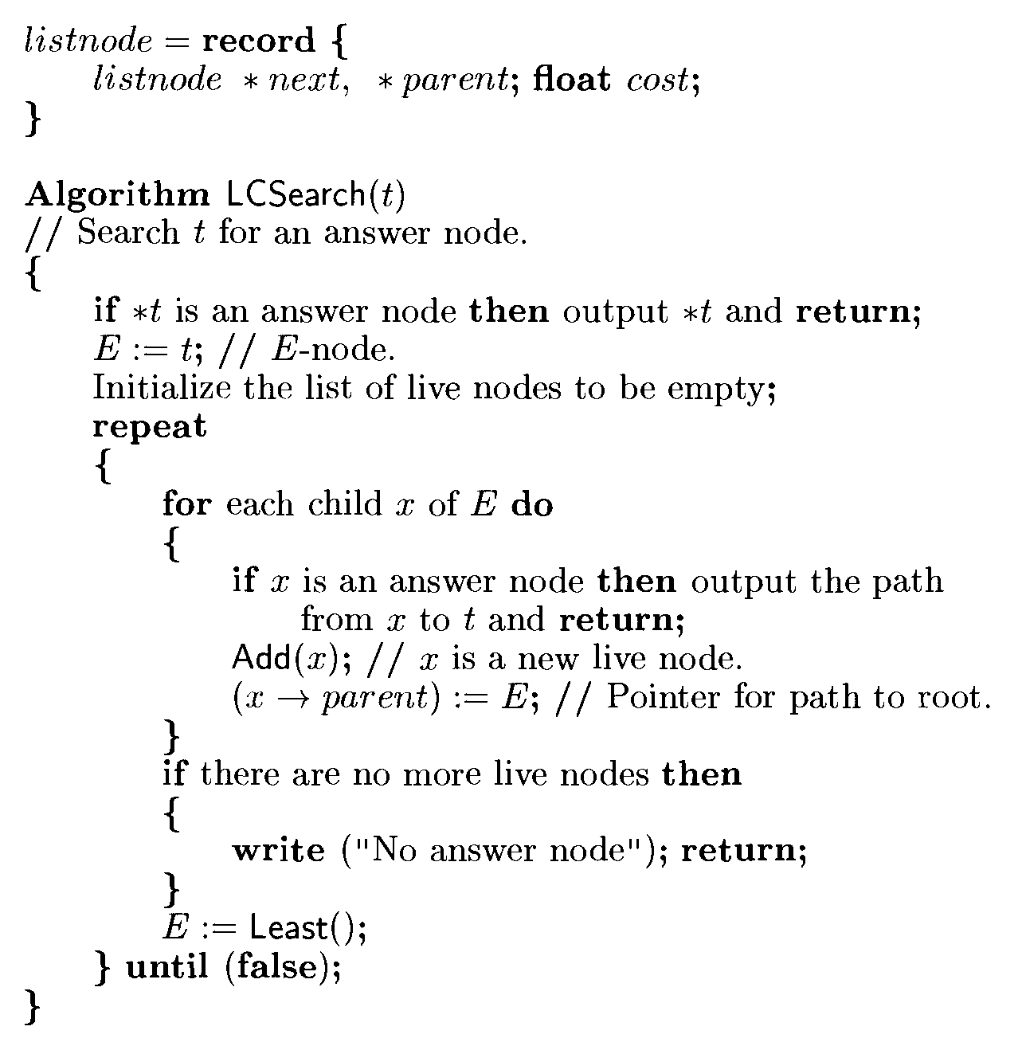
Least Cost Search

Slide 13
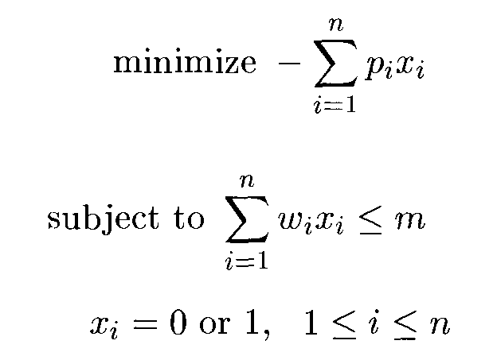

0/1 Knapsack problem using LC Search
Every leaf node in the state space tree representing an assignment for which is an answer (or solution) node.
We now need two functions c^(x) and u(x) such that c^(x) <= c(x) <= u(x) for every node x.

Slide 14
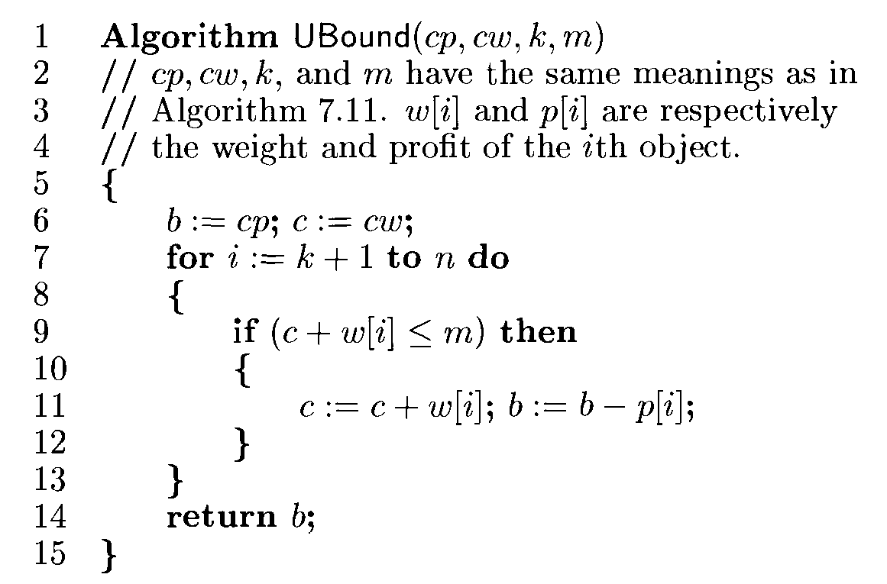
Upperbound function for knapsack problem

Slide 17
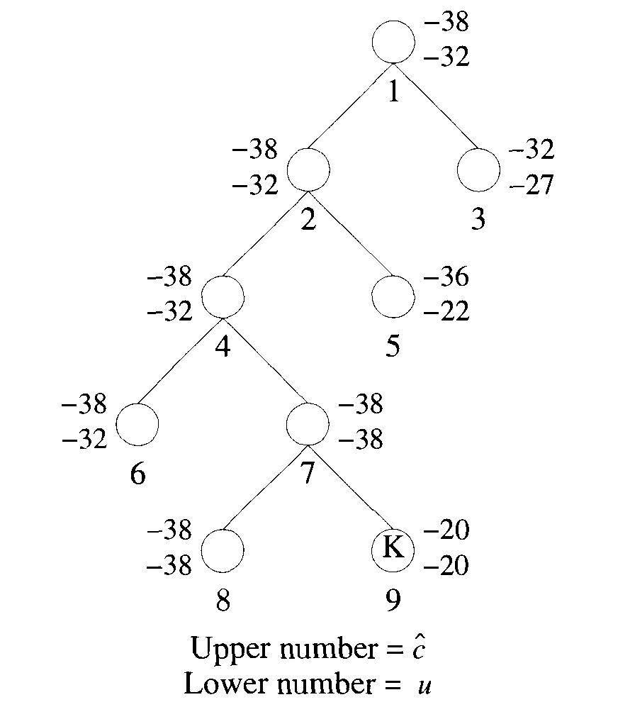
LC branch and bound tree

Slide 21
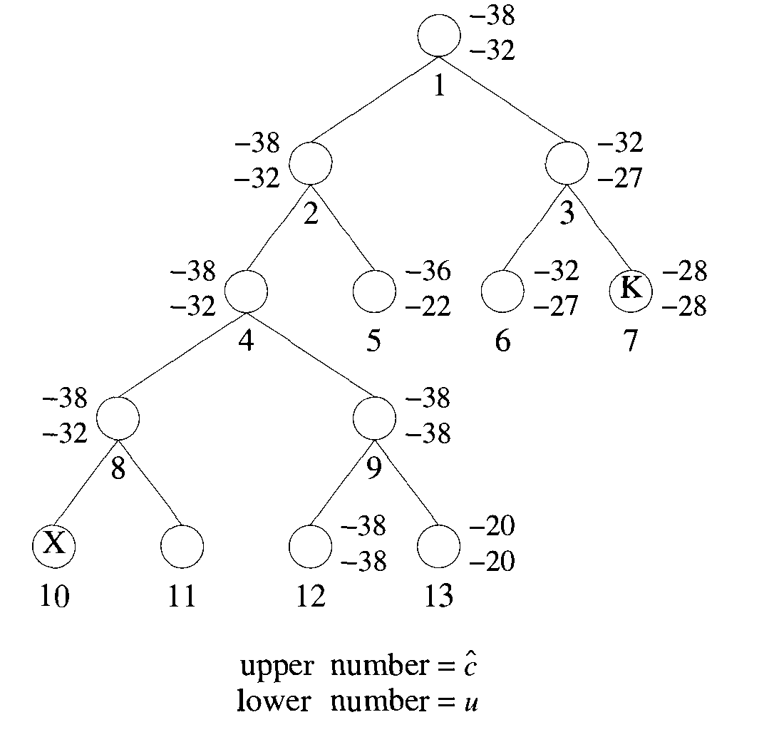
FIFO Search
C^(.)>Upper then node is killed

Slide 22
Assignment no.6
Write a program to solve the travelling salesman problem and to print the path and the cost using Branch and Bound.

